Slide 1
HUMAN COMPUTER INTERACTION
RISHI REDDY
DEPARTMENT OF COMPUTER SCIENCE
DR. C. C. CHAN

Slide 2
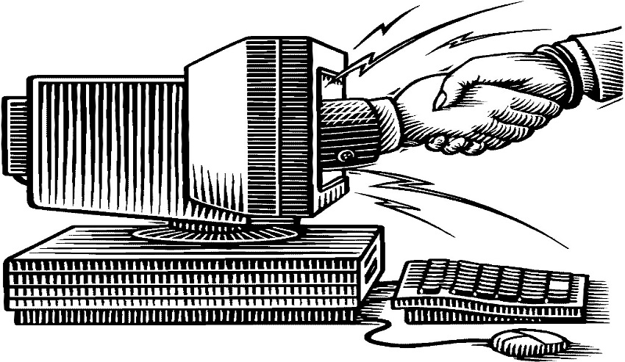
Introduction
Human–computer interaction (HCI) involves the study, planning, and design of the interaction between people and computers
Because human–computer interaction studies a human and a machine in conjunction, it draws from supporting knowledge on both the machine and the human side.
. On the machine side, techniques in computer graphics, operating systems, programming languages. On the human side, communication theory, graphic and industrial design disciplines, linguistics, social sciences are relevant.

Slide 3
Why HCI?
The rapid growth of computing has made effective human-computer interaction essential.
It is important for the growing number of users who could not afford to spend lots of time training and learning new modules.
The need to reduce frustration, and overhead costs such as user training could prove beneficial.
A classic example of this is the Three Mile Island accident, a nuclear meltdown accident, where investigations concluded that the design of the human–machine interface was at least partially responsible for the disaster.
Similarly, accidents in aviation have resulted from manufacturers' decisions to use non-standard flight instrument and/or throttle quadrant layouts:

Slide 4
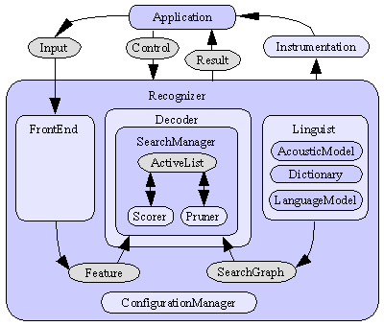
Sphinx4 Architecture
Sphinx4 has three primary modules
Front end
Decoder
Linguist

Slide 5
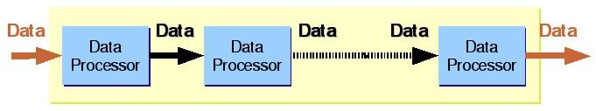
Front End
Takes the data and sends it into an Data Processor.
The Data processor processes it and converts it into a list of features.

Slide 6
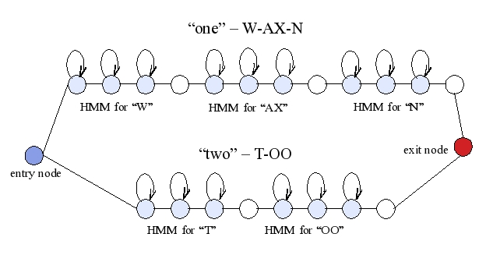
Linguist
Generates Search Graph that is used by decoder.
For every sound its corresponding HMM’s are generated.
Language Model: Recognizes sequence of words.
Dictionary: Provides pronunciation
for the words.
Acoustic Model: It is a mapper
between a unit of speech
and HMM’s that could be
generated.

Slide 7
Decoder
The primary role of the Sphinx-4 Decoder block is to use Features from the Front End along with the Search Graph from the Linguist to output results.
The Decoder block comprises a Search Manager in which and at each step of the process, the Search Manager creates a Result object that contains all the paths that have reached a ﬁnal non-emitting state.

Slide 8

TEXT TO SPEECH
Text-to-speech (TTS) is a open source speech synthesis application
TTS can enable the reading of computer display information
Current TTS applications include voice-enabled e-mail and spoken prompts in voice response systems.
TTS is often used with voice recognition programs.

Slide 9
Java Speech API
Speech Synthesis
Speech Recognition
Sphinx-4
In Collaboration between CMU, Sun Microsystems and Hewlett Packard.
Architecture

Slide 10
TECHNOLOGIES
JDK 6 (J2SE)
Eclipse
Sphinx 4
Java Text To Speech (TTS)

Slide 11
Approach being followed to develop the application
Build a Java file.
Build a grammar file.
Build a configuration file.

Slide 12
Modules
Basic Interactive Calculator Application
Voice Based Search

Slide 13
Interactive calculator
The calculator module we implemented is an interactive one. The input is a string of words to the application.
The Application processes the input and gives the intended output just like any other calculator. The only difference is that the input is given through voice interaction and not through any other input interfaces.
Input: one zero final two zero
Output : 30

Slide 14


A simple example on how we interact with the Application
Hey ! Nine hundred forty nine add
Four hundred sixty five
Its 1414

Slide 15





Desktop Applications

Slide 16
Approach used
Rule Based System
Rule Base
Working Memory
Determine the rule to fire
Select rule to fire
Notes:
when all the rules or rule are satisfied we move to the next state or final state.
suppose if the rule does not match and given set of rules..we dont get a final state and we may even not get a solution.

Slide 17
Problems faced during implementation
Operating system
Test cases
Grammar file
speech recognition systems sometimes makes errors if there is noise or some other sound in the room.
speak loudly than your normal voice

Slide 18
Conclusion
Got lot of importance in the present era
Voice recognition everywhere
Increased human – computer interaction
Speech is a very natural way to interact, and it is not necessary to use a keyboard.
Example: siri

Slide 19
Future Scope
In the future the computer might grasp the meaning of the words .
Maintenance of a log file.
Learning process
Accuracy will become better and better
Greater use will be made of intelligent systems that helps the computer to clearly understand what the user is speak.

Slide 20
DEMO of the Application
Basic Calculator
Voice Based Search

Slide 21
References
http://freetts.sourceforge.net/
http://cmusphinx.sourceforge.net/sphinx4/

Slide 22
THANK YOU

